Slide 1
College on the Cheap: Consequences of Community College Tuition Reductions
Jeff Denning

Slide 2
What is the question?
What is the effect of reducing community college tuition on enrollment patterns?
Democratization versus Diversion--does making CC cheaper reduce 4 year enrollment?
Is this interesting?
Possibly a different response than price four year schools

Slide 3
Is this hard to answer?
Students typically attend the closest community college if they attend community college
Community colleges don’t give out a lot of financial aid
Would this regression work Enrollment=CC Tuition Nearby + XB + e?
Comparisons of community colleges with high and low tuition may conflate the effect of tuition with underlying differences in places with high versus low tuition.
What would be the ideal experiment?

Slide 4
Setting
In Texas, community colleges are supported by taxing districts.
If you live in an area that pays taxes to support a community college you get discount on tuition--this is called “in district tuition”
Five community colleges saw changes in their districts in the period studied in Texas.
One confusing thing: there are community college taxing districts and K-12 districts in this paper
Data
Administrative data from all high school graduates on all public college enrollment
How did the author collect data on changes in boundaries?

Slide 5
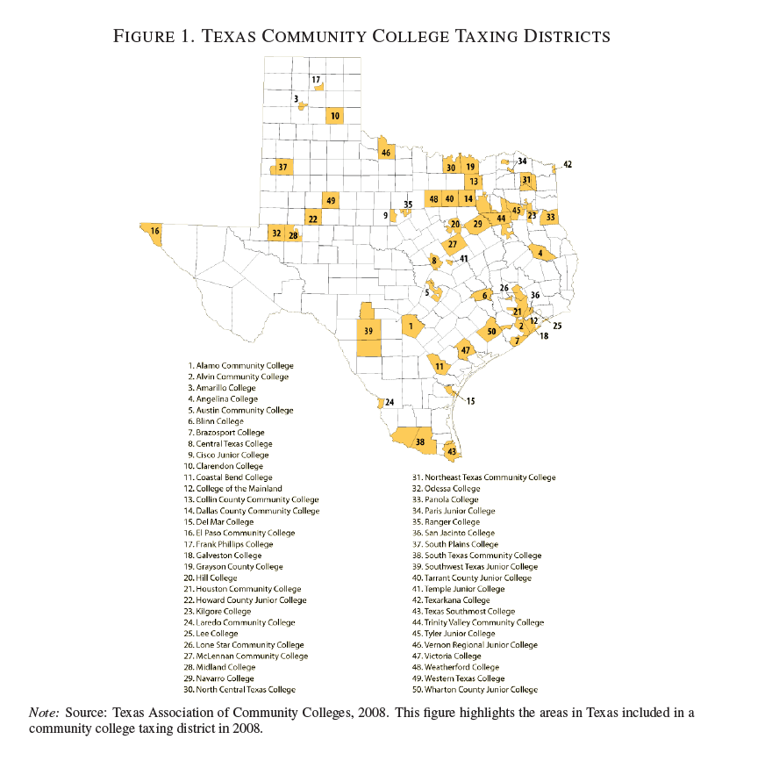
Great State of Texas CC System

Slide 6
Annexation
Municipalities (usually K-12 districts) can decide to join a CC taxing district.
If they do, they raise their property taxes and lower their tuition
This is done by voting. Is this ideal?
What comparisons could you make?
Annexed vs. never annexed
Annexed vs. already included
What comparisons does the author make?
Annexed vs. already included. Why?

Slide 7
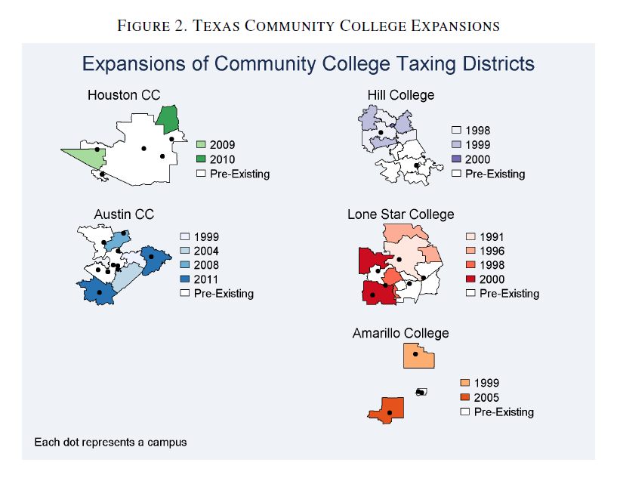
Annexations

Slide 8
How many “observations” does the author have?
In the case of a 2X2 difference in differences what is treatment unit? E.g. In Card/Krueger there are essentially 4 observations (NJ/PA X Before/After)
In this case there are 22 treated groups (and a similar number of control groups)
To account for this, the author “clusters” standard errors. Another way to do this is to collapse the data to be means by K-12 district and year.

Slide 9
Estimating Equation
i indexes people, d indexes K12 districts, t indexes year, c indexes college
Y is an outcome, Annexation is an indicator of Annexation, X are person level covariates, W are city level covariates
What does each of these things account for?
Can we include fixed effects for K-12 district by time?
What is Tau? Why is this nice to include?

Slide 10
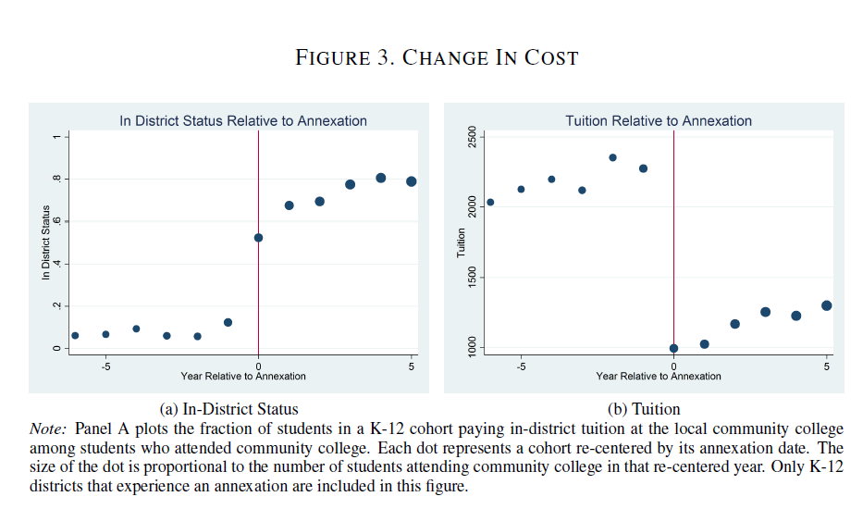
Change in Tuition/First Stage

Slide 11
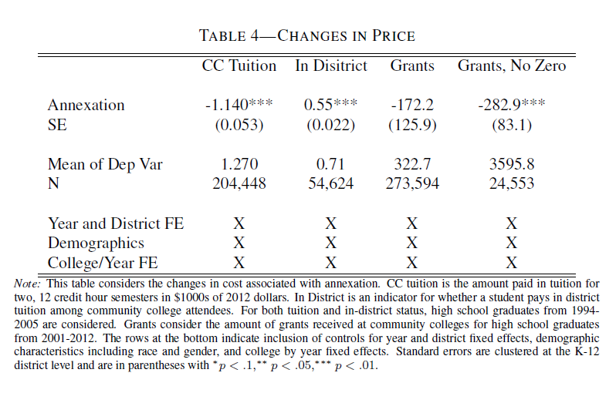
Table Version

Slide 12
Assumptions
What needs to be true for the author’s preferred interpretation?
Parallel Trends--what does that mean in this particular case?
How can we test?
Nothing else changes
Pre Trends

Slide 13
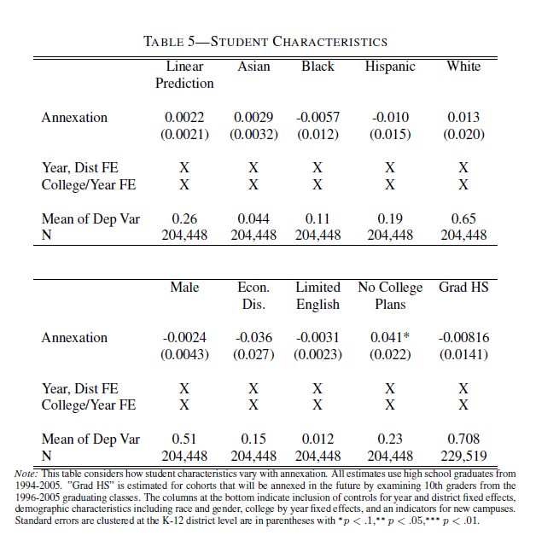
Changing Demographics?

Slide 14
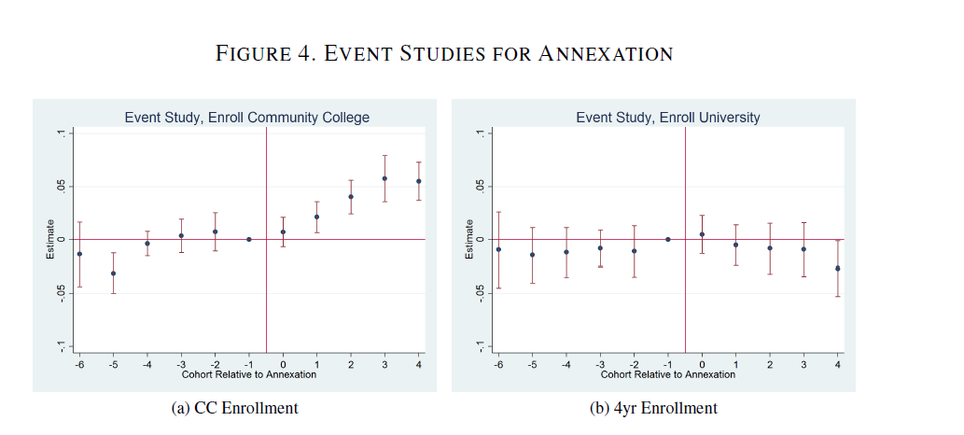
“Money” Graph

Slide 15
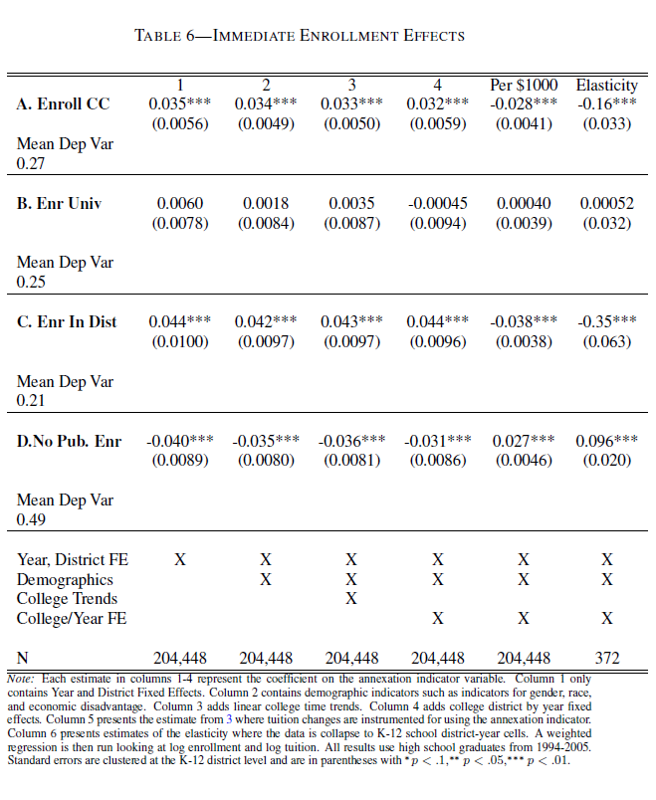
Table Version

Slide 16
Identifying Assumptions
Parallel trends in the pre period? (Yes)
Other changes? (Yes)
Sometimes this meant a new facility was built
What does the author do to address this?
Why is this important for the preferred interpretation? What is the preferred interpretation?
What would be the interpretation if he did not include new building indicators?

Slide 17
Conclusions
Community college tuition seems to affect college enrollment
It does not seem that it decreases 4 year enrollment (no diversion)
Plotting the event study is useful

Slide 18

Research can affect policy

